Slide 1
On Finding Dense Subgraphs and Applications to Gene Annotation Graphs
Ron Zeira
AGCT internal meeting
11.1.2012

Slide 2
Agenda
Finding dense subgraphs in undirected graphs with/out restrictions:
Goldberg’84
Charikar’00
Andersen&Chelapilla’08
Saha&Khuller’09
Applications to Gene Annotation Graphs:
Saha, Hoch, Khuller, Raschid, Zhang – RECOMB’10

Slide 3
Dense subgraph definition
Given an undirected graph G=(V,E), density of a subgraph S⊆V is defined as
where E(S) is the set of edges in the subgraph induced by nodes in S.
Note that 2d(S) is simply the average degree of the subgraph induced by S.
For weighted graphs
Notes:
Can also be extended to weights on the nodes
Can also be extended to directed graphs

Slide 4
Dense subgraphs problems
Given an undirected graph G=(V,E):
Find the densest subgraph.
Find the densest subgraph with exactly k vertices.
Find the densest subgraph with at least k vertices.
Find the densest subgraph with at most k vertices.
Notes:
Spoiler alert – complexity results

Slide 5
Maximum density subgraphs problem
Maximum density subgraph can be found in polynomial time for undirected graphs:
Combinatorial algorithms based on maxflow computations[Lawler’76, Goldberg’84].
Linear programming based algorithm [Charikar’00].
Fast linear time algorithms for computing 2-approximate solutions [Kortsarz & Peleg’92, Charikar’00].

Slide 6
Densest k subgraph problem
NP hard.
Best approximation algorithm known: |V|^{1/3-ε} [Feige, Kortsarz, Peleg’93].
Best hardness result known: No PTAS exists [Khot’04].
Notes:
For k~V there is a constant approximation but not in the general case.
Explain approximation and PTAS (polynomial time approximation scheme)

Slide 7
Densest at least k subgraph problem
NP-Hard [Saha, Khuller’09].
3-approximation linear time greedy algorithm [Andersen,Chelapilla’08].
2-approximation combinatorial algorithm based on parametric flow computation [Saha, Khuller’09].
2-approximation LP rounding based algorithm [Saha, Khuller’09].

Slide 8
Densest at most k subgraph problem
NP-Hard.
A γ approximation algorithm for densest at most k subgraph problem implies a 4 γ approximation algorithm for the densest k subgraph problem [Saha, Khuller’09].

Slide 9
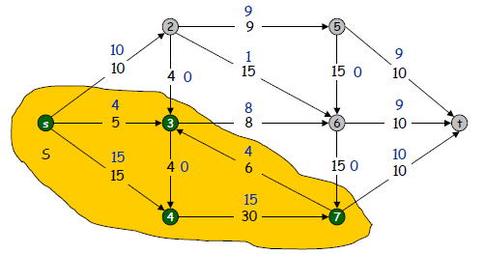
Max flow min cut - reminder
Network: abstraction for material FLOWING through the edges.
Max flow problem: Assign flow to edges to maximize flow sent from s to t.
Min cut problem: Delete "best" set of edges to disconnect t from s.
• http://www.Princeton.EDU/~cos226

Slide 10
Flow based maximum density
Given an undirected graph construct a directed flow network as follows:
Guess g, the densest subgraph’s density.
Add source and target nodes.
Edges from source to original nodes: m’= sum of all edges in graph.
Edge from original node i to sink: m’ + 2g – degree(i).
Turn the original edges to bi-directional edges.

Slide 11
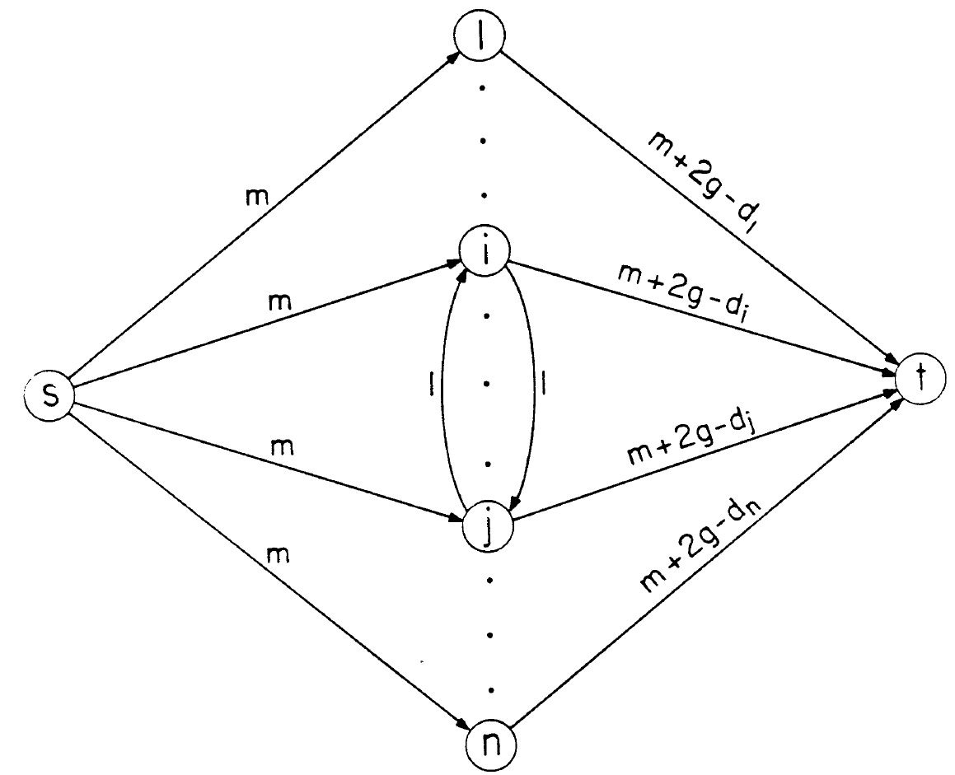

Slide 12
Flow based maximum density
The trivial cut (that include only s) is m|V|.
Theorem [Goldberg’84]:
If the source is not the only node in it’s side of the cut then the guess is at most the true max density.
If the source is the only node in it’s side of the cut then the guess is at least the true max density.
Proof sketch:
Write the value of the cut as a function of the set of original nodes on the source’s side.
Use the trivial cut bound.

Slide 13
Flow based maximum density
Binary search for the correct guess of g.
Stop search when the interval is below 1/n² .
Output the nodes on the source side of the cut.
Running time: O( log(n) * Min_Cut(G) )

Slide 14
LP based maximum density
Notes:
Can be extended to the weighted version

Slide 15
LP based maximum density
Lemma 1 [Charikar’00]: for any S⊆V the LP is at least d(S).
Proof: y_{i},x_{i,j}=1/|S| for i,jεS is a feasible solution to LP.
Lemma 2 [Charikar’00]: Given a feasible solution to the LP with a value ν we can construct S⊆V s.t ν≤d(S).
Proof: for a parameter 0≤r define S(r) (E(r)) as the set of indexes with y’s(x’s) at least r.
Using the LP constraints show the E(r) is the set of edges induces by S(r).
The integral over S(r) (E(r)) is the sum of y’s(x’s).
By contradiction: for no r, the subgraph’s density is at least ν.

Slide 16
LP based maximum density
Given a solution to the LP:
Consider each value of y and obtain the subset with the maximum density [Charikar’00].
Theorem: There exists a solution of the LP such that all the y_{i} variables are equal [Saha, Khuller’09].
Corollary: For any solution of LP, the vertices with non-zero y_{i} constitute a densest subgraph.

Slide 17
Maximum density approximation
We want to produce a subgraph with a large average degree. Intuitively, we should throw away low degree vertices.
Notes:
Greedy 2 approximation

Slide 18
Maximum density approximation
Theorem: The algorithm achieves a 2-approximation for the maximum density.
Proof [Saha, Khuller’09]:
In an optimum solution, every vertex has degree at least OPT.
When the first vertex of the optimum solution is selected, all the vertices in the remaining subgraph have degree at least OPT.
The total number of edges is at least OPT*|S|/2 and the density at least OPT/2,
Notes:
Let dOPT = . Observe that in an optimum solution, every vertex has degree
. Otherwise removing a vertex of degree < , will give a subgraph with higher density.
Consider the iteration of the greedy algorithm when the first vertex of the optimum solution
is removed. At this stage all the vertices in the remaining subgraph have degree . If
the number of vertices in the subgraph is s, then the total number of edges is s/2, and
the density is /2. Since the greedy algorithm returns the subgraph with the highest
density over all the iterations, it always returns a subgraph with density at least 1
2 of the
optimum.
Linear algorithm in comparison to quadruple for the flow alogorithm. Important for large networks

Slide 19
Densest at least k subgraph
NP hard – reduction from densest k subgraph [Saha, Khuller’09].
Simple 3-approximation [Andersen,Chelapilla’08]:
In the greedy algorithm, output the subgraph H_{i} with the largest density d(H_{i}) over all i ≥ k.
Notes:
Proof omitted

Slide 20
Densest at least k subgraph
a combinatorial algorithm that requires only max(1, k −d(G)) parametric flow computations and achieves 2-approximation.[Saha, Khuller’09]:
Notes:
Proof omitted
All the
edges and the vertices of Hi are removed from Gi−1. For every vertex v 2 Gi−1 \ Hi,
if v has l edges to the vertices in Hi, then in Gi a self loop of weight l is added to v.

Slide 21
Densest at least k subgraph
LP rounding based algorithm that achieves an approximation factor of 2 and requires to solve the LP only once [Saha, Khuller’09]:
Here l≥k is the size of the optimum solution of the DalkS problem.
Notes:
Proof omitted – similar to the exact LP

Slide 22
Densest at most k subgraph
The densest at-most-k-subgraph problem is NP-complete.
Reduction to the max-clique problem:
A subgraph of size at most k has density at least (k − 1)/2 if and only if it is a k-clique.

Slide 23
Applications to Gene Annotation Graphs
Dense Subgraphs with Restrictions and Applications to Gene Annotation Graphs
Barna Saha, Allison Hoch, Samir Khuller, Louiqa Raschid, and Xiao-Ning Zhang
RECOMB 2010
Figures from Samir Khuller’s presentation.

Slide 24
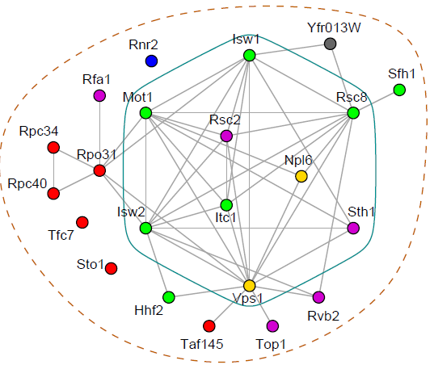
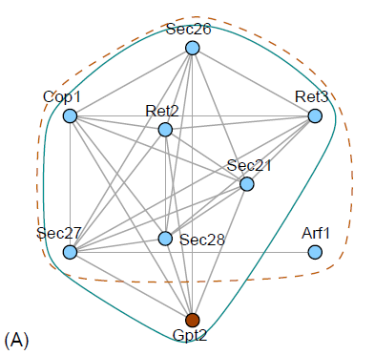
Motivation
Biological knowledge often can be represented as graphs:
Protein Interactions, Metabolic Pathways, Gene Regulation, Gene Annotation…
Dense regions in graphs may represent useful information.
Notes:
MIPS complex in the yeast network Y_{11k} and the matching complex obtained by the densest subgraph algorithm

Slide 25
Gene Annotation Data
The paper focus on TAIR.
The goal is to integrate gene GO and PO annotations to find meaningful complex patterns.
The hierarchical annotation structure can also be used.
Notes:
The Arabidopsis Information Resource
Associations between GO and PO CV Terms Gene CRY1
Semantic relationships in Gene Ontology GO

Slide 26
Gene Annotation Graph
Construct graphs for each gene using their GO, PO annotations.
Combine the graphs of several genes into one single weighted graph (bi-partite).
GO 1
Gene 1
PO 1
GO 1
1
PO 1
2
1
GO 2
PO 2
GO 2
3
2
PO 2
Gene 2
1
1
3
GO 3
PO 3
GO 3
1
PO 3
Gene 3
2
1
GO 4
PO 4
GO 4
3
PO 4
Gene 4
1
Notes:
our algorithm works equally well for general graphs

Slide 27
Distance Restricted Densest Subgraph Problem
Given a bipartite graph G = (A,B,E) and a distance function between nodes in A(B). In addition there are distance thresholds for A and B.
The goal is to find the densest subgraph that the nodes are below the thresholds.
Theorem: When the distance function is an arbitrary metric, the problem is NP-hard and at least as hard to approximate as the maximum independent set problem.

Slide 28
Distance Restricted Densest Subgraph
When the distance function comes from the shortest path in a graph (as in our case), there is a polynomial solution.
The high level idea is to select a polynomial collection of subgraphs and compute the densest subgraph for each one. The following properties should hold:
Distance property is satisfied in each subgraph.
Some subgraph contains the true optimum.
Notes:
This gives rise to a polynomial time algorithm,
albeit with a rather high polynomial complexity. Luckily, in practice, the subgraphs
we run the computation on are significantly smaller than the entire graph,
so the algorithm runs fairly quickly

Slide 29
Densest Subgraphs with a Specified Subset
Densest subgraph problem where a subset C of the nodes must appear in the solution.
Allow a weight function on the edges and the nodes.
The density is the sum of edge weights to the sum of node weights.

Slide 30
Densest Subgraphs with a Specified Subset algorithm
Contract the subset C into a single node c.
Solution is based on a flow network similar to the unconstrained problem.
Add a network node for each original edge connected to s.
Add a network node for each original node connected to t.
Add edges between the “edges nodes” and their corresponding nodes.
Add a new source s’ connected to s.
Binary search the correct density.

Slide 31
All almost Maximum Densest Subgraphs
Sometimes subgraphs having density close to the maximum might be interesting as well.
Given a graph G with optimal density α* we want all subsets S such that d(S)≥(1-ε/|S|)α*.
Algorithm idea:
Construct the flow network for α* .
Find all the cuts that are at most εα* from the min cut of α*.
From the cuts detect dense subsets.

Slide 32
All almost Maximum Densest Subgraphs
Picard and Queyranne’s algorithm reduces the problem of finding all the minimal cuts to an enumeration on closure binary relations defined by the residual network.
A simple modification enables detecting all the εα* cuts.

Slide 33
Photomorphogenesis Experiment
10 Photomorphogenesis genes.
66 GO CV terms. 41 PO CV terms; 2230 GO-PO edges.
Generate distance restricted dense subgraph:
GO distance = 2.
PO distance = 3.
Result: Dense subgraph with 3 GO terms, 13 PO terms, 39 edges and 9 genes.
Notes:
The complex pattern is consistent with the literature

Slide 34
Photomorphogenesis Experiment
GO CV Terms PO CV Terms
5634-nucleus:cellular-component 13-cauline leaf:plant structure 9010-seed:plant structure
5794-Golgi apparatus;cellular-comp 37-shoot apex:plant struture 9025-leaf:plant structure
5773-vacuole:cellular-component 8034-leaf whorl:plant structure 9031-sepal:plant structure
9005-root;plant struture 9032-petal-plant structure
9006- shhot:plant structure 9047-stem:plant structure
9009-embryo;plant structure 20030-cotyledon:plant structure
20038: petiole:plant structure
5634-13 5634-37 5773-13 5773-37
HFR1 (AT1G02340) 1 0 0 0
CRY2 (AT1G04400) 1 1 1 1
CIB5 (AT1G26260) 1 1 0 0
COP1 (AT2G32950) 1 1 0 0
PHOT1 (AT3G45780) 0 0 1 1
CRY1 (AT4G08920) 1 1 0 0
SHB1 (AT4G25350) 1 0 0 0
HY5 (AT5G11260) 1 1 0 0
PHOT2 (AT5G5840) 0 0 0 0
CIB1 (AT4G34530) 0 0 0 0
Novel?
Functional interaction
Notes:
Potential Complex Pattern of Photomorphogenesis Genes
HFR1 is not annotated with the following GO and PO combination: (5634:
nucleus; cellular component and 37: shoot apex; plant structure).
This is indicated by an arrow in Figure 3. A review of the literature suggests
that this is a novel observation about the mechanism controlling this gene
that should be pursued further.
This patterns has not been reported in the literature.
Two independent studies [Kang et al. Planta 08, Ohgishi PNAS 04] have suggested that there may be some functional interactions between the members of PHOT1 and CRY2 in vacuole

Slide 35
Controlled experiment
Add 10 control genes.
Generate dense subgraph:
14 genes, 4 GO terms, 11 PO terms and 44 edges.
8 photo` genes and 6 control genes.
Missing 1(3) GO(PO) terms. Additional 2(1) terms.
Generate subset restricted (2,2) subgraph:
Dense subgraph with 2 GO terms, 12 PO terms.
User validated that the missing PO term and additional control genes and edges were acceptable.

Slide 36
Future work
Developing a NULL hypothesis:
Control genes.
Density distribution from random graphs.
Use all almost dense subgraphs.
Random labeling of the terms.

Slide 37
My impressions
Nice theoretical analysis.
Dense subgraphs with restrictions can be applied in other biological domains.
Although polynomial algorithms, running time may be an issue in other graphs.
Distance based on the annotation graph?
Only user validation?

